Slide 1
What are the New York State Tests?
January 24th, 2016
P.S. 174 Q
Presented by: Rich Bebenroth and Marie Russell

Slide 2
State Test Information: Students
Students in third through fifth grade will take the NYS ELA and Mathematics Assessment.
Certain English Language Learners are exempt from the NYS ELA. If you have questions about exemption please contact your child’s classroom or ELL teacher.
Fourth grade students will take the NYS Science Assessment. An additional workshop will be held to provide information.

Slide 3
State Test Information: Dates
ELA
March 28,29,30 Tuesday-Thursday
Math
May 2,3,4 Tuesday-Thursday
Spring Recess April 8th-April 18th (Please avoid extending your family vacation).

Slide 4
Timing
Tests are untimed
Students may work for as long as they need, as long as they are working productively
If a student is still working, and the rest of their class has completed the test, they may be moved to another room to complete their test

Slide 5
Types of Questions ELA
Multiple Choice
Students read a passage and answer multiple choice questions about the passage. Questions could be factual, inferential, checking for meaning, or interpretative.
Short Answer
Students will write a short response, one or two sentences, to answer a question relating to the story.
Extended Response
Students will write a longer essay, often comparing two passages. These sometimes will compare characters, situations, or settings.
Samples from: https://www.engageny.org/resource/released-2016-3-8-ela-and-mathematics-state-test-questions

Slide 6
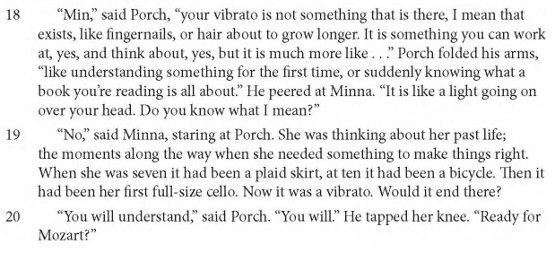
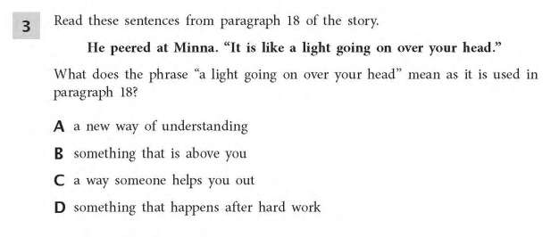
Multiple Choice Sample

Slide 7
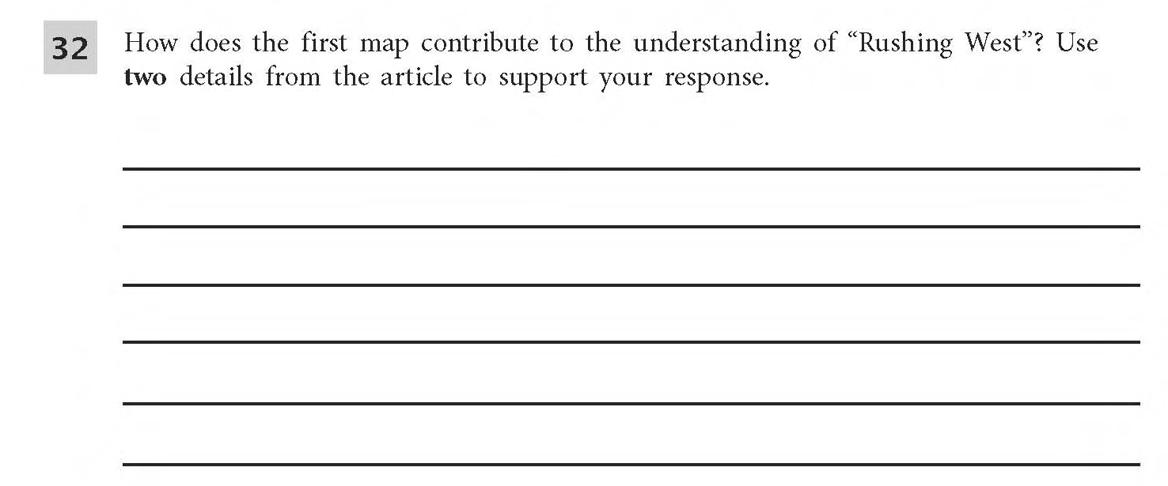
Short Answer Question

Slide 8
Extended Response Question

Slide 9
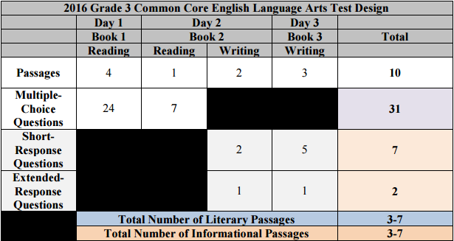
State Test Information: English language Arts
This table reflects 2016 data, 2017 is not released yet.
We do not anticipate any changes.

Slide 10
State Test Information: English language Arts
This table reflects 2016 data, 2017 is not released yet.
We do not anticipate any changes.

Slide 11
State Test Information: English language Arts
This table reflects 2016 data, 2017 is not released yet.
We do not anticipate any changes.

Slide 12
State Test Information: Timing Mathematics
This table reflects 2015 data, 2016 is not released yet.
Proposed shorter times and less questions and passages for 2016
Third and fourth grade
Fifth grade

Slide 13
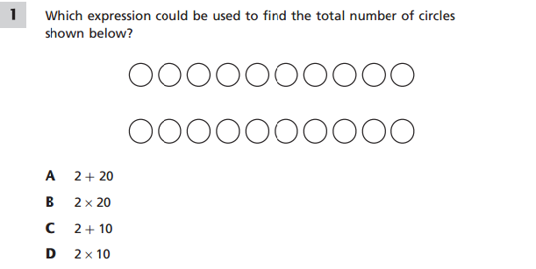
Types of Questions Math
Multiple choice
Sample from 3rd grade NYS released questions

Slide 14
Types of Questions Math
Short Answer
A cargo ship is carrying nine shipping crates. Each crate is equal in mass, and the total mass of all nine crates is 4,707 kilograms. What is the mass, in kilograms, of each crate?
Show your work.
Sample from 4th grade NYS released questions

Slide 15
Types of Questions Math
Extended Response
There are 12 players on a new softball team. Before the team starts playing games, the team must pay a total registration fee of $572. Along with the registration fee, the team will also need to spend a total of $1,240 on equipment. To pay for the cost of the registration fee and the equipment, the players held a car wash and raised $786. They then decided to sell candles for $9.50 per candle to cover the remaining costs. If each player sells the same number of candles, how many candles must each player sell?
Show your work.
Sample from 5th grade NYS released questions

Slide 16
Ways to help your child at home
Provide a quiet space for homework. Make sure supplies are available – paper, scissors, glue, crayons, pens, pencils, etc.
Set up routines and reinforce good habits. – homework time, reading time, etc.
Encourage your child to read to you. Have books and magazines around the house.
Visit your local library. Borrow books and magazines in different genres.
Be a good listener – ask your child about the activities they are doing at school.
Reinforce the skills and concepts your child is learning at school, e.g. math skills through cooking and shopping, writing notes, etc.
Give your child as many different experiences as possible – take trips to museums, the zoo, shows, etc.

Slide 17
Test Taking Tips
Do not put undue pressure on your child.
Make sure they get a good night’s sleep.
Make sure they eat breakfast the day of the test.
Do not send your child to take the test if they are not feeling well (there are makeup days).
Your child should bring three sharpened #2 pencils with erasers, but no “lucky pencils” or “special erasers” as they can be a distractor.
Let them know that once the test is over, it is a normal day and the test is just a small part of that day.

Slide 18
Links
http://engageny.org/resource/test-guides-for-english-language-arts-and-mathematics
http://schools.nyc.gov/Academics/CommonCoreLibrary/default.htm
http://www.engageny.org/resource/released-2016-3-8-ela-and-mathematics-state-test-questions

